Slide 1
Alluvial Examples: Illustration purposes only (not vetted)
Dave Anderson

Slide 2
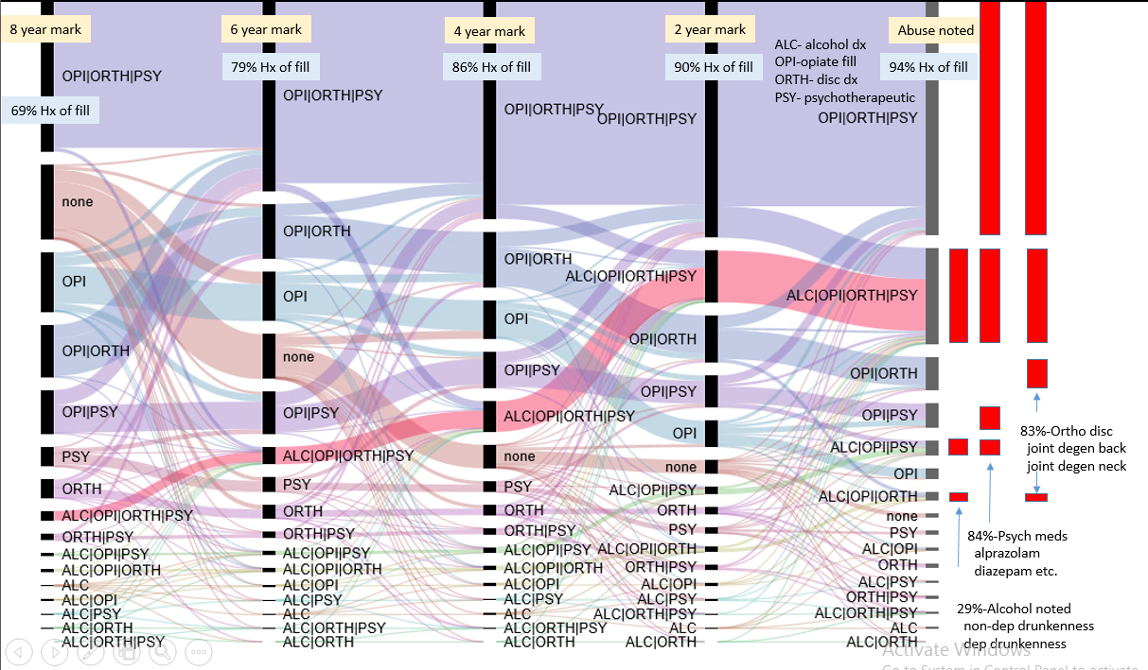
Precursor events by CY prior to Opioid abuse diagnosis
Notes:
------- 10 yr opioid abuse pathway example through the lens of psych fills , lumbar, alcohol, opioid fill visibility
This represents the culmenation of individual stories through the lens of the 4 “events”. Each bar represents a history measurement of that measurement (e.g. 6 year bar set is 10 years to 6 years, 4 year bar set is 10 years to 4 years, etc.)
10 years CE med+pharm prior to opioid event
Opioid dependence and abuse sets (perhaps too wide a net: 304.0x, 304.7x,305.5x, F11.1)
subsequent note: using abuse only has similar distributions
Far left bar measures combinations from all past history to 8 years prior (at least 2 years of CE Hx)
69% of the member at this mark have at least one fill of an opioid
By day zero (abuse code)
94% of the members have at least one opioid fill
84% of the members have at least one psych fill
83% at least one dx for lumbar degen
29% alcohol related codes (though I did include non-alcohol cirrhosis)

Slide 3
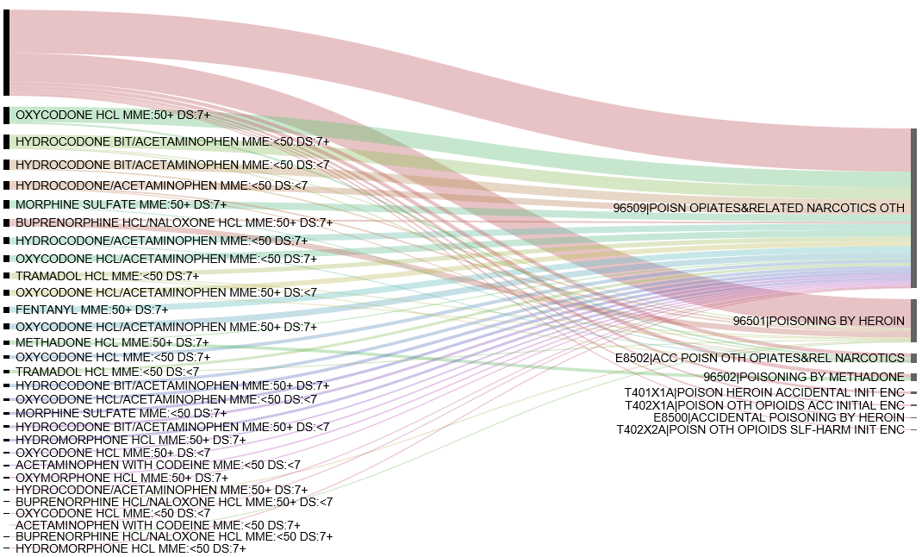
Opioid overdoses: opioid filled at least 30 days prior ==> specific poisoning code
Last fill by name,
MME and supply
No opioid fill seen
Specific (OD)
Poisoning code

Slide 4
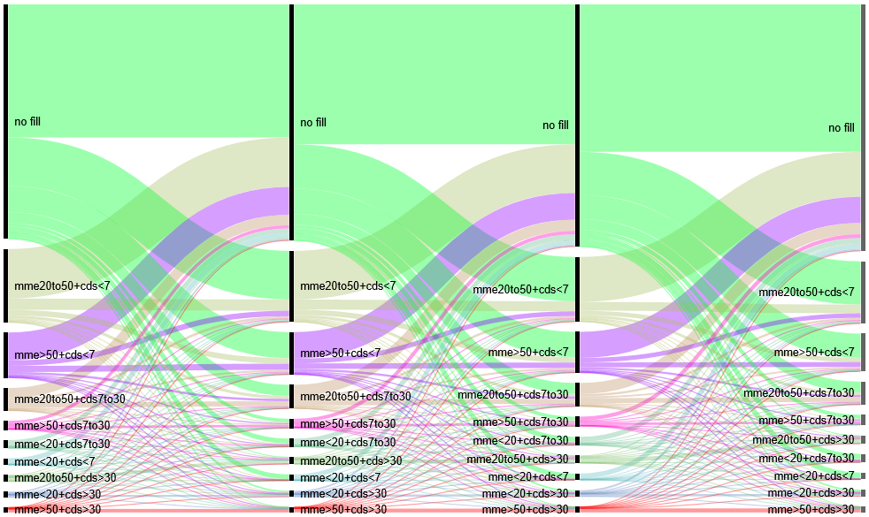
All members with CE from 2012 through 2015 with at least one opioid fill (N=1.2M fillers with this significant CE) When multiple fills occur in a CY use only the highest MME (and its days_supply, no composites)
CY 2012
CY 2013
CY 2014
CY 2015
Year to year this is fairly “steady state”
.. Need to rerun to access 2017 CDC
policy impact
Notes:
run was an attempt to visualize the following..
What I get out of it at the static calendar year level
Distributions of MMEs each CY
Distributions of days of supply each CY
Distributions of MME/days of supply combinations each CY
What I get out of it across calendar years
The number of people that transition to higher dosages, lower dosages, or stop filling across time
e.g. 132K members are in the 2012 MME>50, day supply <7 group (again sorry for the color)
81K did not fill the next year
16K had another fill at the same level
The rest transitioned to other dosages/day supply
Consistency of those transitions and raw magnitudes over the study period (we can expect that our CY cuts to be relatively consistent over the study period per the limitations of the way this was done)

Slide 5
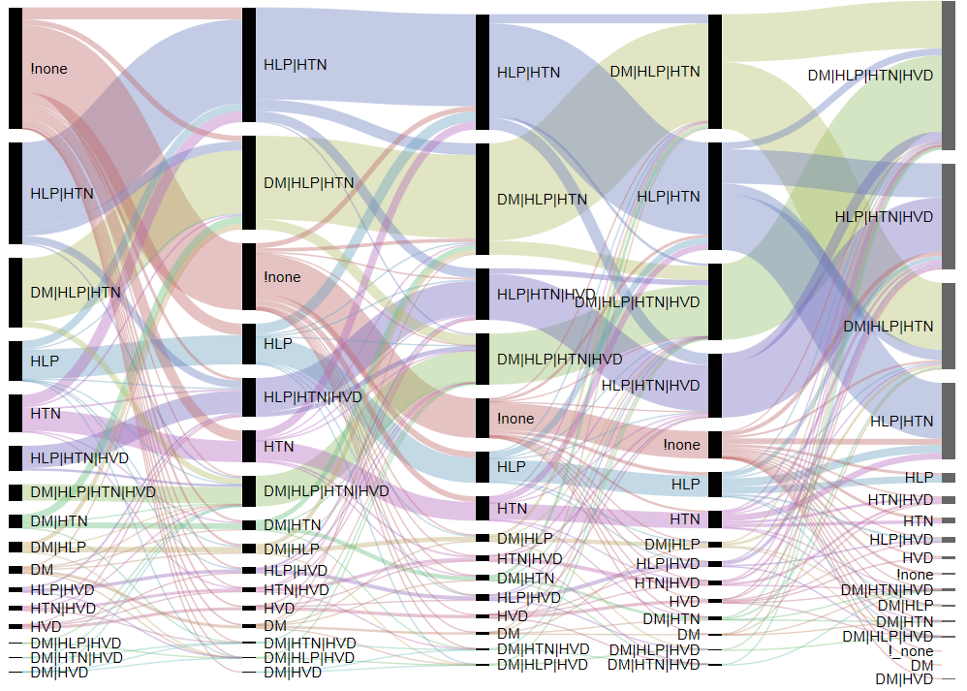
8 years prior
6 years prior
4 years prior
2 years prior
Day of CABG
Paths to Bypass
DM-diabetes
HLP- hyperlipidemia
HTN- hypertension
HVD- heart valve disease
Comorbidity progression to CABG (~3.5K)
Notes:
-- use CTAS or if you want to tweak steal the matched_set SQL and modify
CREATE TABLE matched_cabg AS
SELECT p.age_at_onset ,
p.gender ,
p.year_of_onset ,
p.hrrnum ,
p.individual_id primary_id ,
p.min_dos primary_min_dos ,
p.individual_id comparison_id ,
p.min_dos comparison_min_dos
FROM ( SELECT anchor.individual_id ,
anchor.min_dos ,
date_part('year',anchor.min_dos) year_of_onset ,
gender ,
date_part('year',anchor.min_dos)-year_of_birth age_at_onset ,
hrrnum ,
row_number() over (partition BY date_part('year',anchor.min_dos)-year_of_birth,gender,date_part('year',anchor.min_dos),hrrnum ORDER BY random()) rn
FROM ( SELECT *
FROM ( SELECT individual_id ,
SUM(venn) venn_group ,
MAX(a_min_dos ) min_dos ,
MAX(i_min_dos) i_min_dos ,
MAX(e_min_dos) e_min_dos
FROM ( SELECT individual_id,
1 venn ,
min_dos a_min_dos ,
to_date('1800-01-01','yyyy-mm-dd') i_min_dos ,
to_date('1800-01-01','yyyy-mm-dd') e_min_dos
FROM p_anchor_dande42_C40AFE0F6722EBB27A1FD68FB8577066
UNION ALL
SELECT individual_id,
10 venn ,
to_date('1800-01-01','yyyy-mm-dd') a_min_dos ,
min_dos i_min_dos ,
to_date('1800-01-01','yyyy-mm-dd') e_min_dos
FROM p_inclusion_dande42_C40AFE0F6722EBB27A1FD68FB8577066
UNION ALL
SELECT individual_id,
100 venn ,
to_date('1800-01-01','yyyy-mm-dd') a_min_dos,
to_date('1800-01-01','yyyy-mm-dd') i_min_dos,
min_dos e_min_dos
FROM p_exclusion_dande42_C40AFE0F6722EBB27A1FD68FB8577066
)
venn
GROUP BY individual_id
)
venn2 ,
(SELECT COUNT(0) inclusion_count
FROM p_inclusion_dande42_C40AFE0F6722EBB27A1FD68FB8577066
)
inclusion_in_play ,
(SELECT COUNT(0) exclusion_count
FROM p_exclusion_dande42_C40AFE0F6722EBB27A1FD68FB8577066
)
exclusion_in_play
WHERE venn_group IN (1,11,111,101)
AND
(
(
inclusion_count>0
AND i_min_dos BETWEEN min_dos + -9999 AND min_dos + 9999
)
OR inclusion_count=0
)
AND
(
(
exclusion_count>0
AND e_min_dos NOT BETWEEN min_dos + -9999 AND min_dos + 9999
)
OR exclusion_count=0
)
)
anchor ,
nhd_med_pharm_span_plus x
WHERE anchor.individual_id=x.individual_id
AND anchor.min_dos BETWEEN span_start + 3600 AND span_end - 0
AND date_part('year',anchor.min_dos) - year_of_birth BETWEEN 0 AND 999
AND gender IN( 'M',
'F' )
AND date_part('year',anchor.min_dos) BETWEEN 1994 AND 2014
AND
(
(
x.BUSINESS_LINE_CODE = 'COM'
AND x.FUNDING_PHI_IND IN (0,
1)
AND x.PACIFICARE_IND IN (0)
)
OR
(
x.BUSINESS_LINE_CODE = 'MCR'
AND x.FUNDING_PHI_IND IN (0,
1)
AND x.PACIFICARE_IND IN (0)
)
OR
(
x.BUSINESS_LINE_CODE = 'MCD'
AND x.FUNDING_PHI_IND IN (-1)
AND x.PACIFICARE_IND IN (-1)
)
)
)
p
--- create mask, throttle at 3+
select * from foo_mask
create table foo_mask as
select mask,case when set_cnt>=3 then '3+' else mask_lbl end mask_lbl
from
(
select 0 mask,0 set_cnt,'!_none' mask_lbl
union
select mask,max(set_cnt) set_cnt,min(mask_lbl) mask_lbl
from
(
select source1.*
,d1+decode( d2,d1,0,d2)+decode(d3,d1,0,d2,0,d3)+decode(d4,d1,0,d2,0,d3,0,d4)+decode(d5,d1,0,d2,0,d3,0,d4,0,d5)+decode(d6,d1,0,d2,0,d3,0,d4,0,d5,0,d6) mask
,l1||decode( d2,d1,'','|'||l2)||decode(d3,d1,'',d2,'','|'||l3)||decode(d4,d1,'',d2,'',d3,'','|'||l4)||decode(d5,d1,'',d2,'',d3,'',d4,'','|'||l5)||decode(d6,d1,'',d2,'',d3,'',d4,'',d5,'','|'||l6) mask_lbl
from
(
select iv1.disease_set+iv2.disease_set+iv3.disease_set+iv4.disease_set+iv5.disease_set+iv6.disease_set set_sum
,decode(iv1.disease_set,1,1,0)+decode(iv2.disease_set,10,1,0)+decode(iv3.disease_set,100,1,0)+decode(iv4.disease_set,1000,1,0)+decode(iv5.disease_set,10000,1,0)+decode(iv6.disease_set,100000,1,0) set_cnt
,iv1.disease_set d1,iv1.disease_lbl l1,iv2.disease_set d2,iv2.disease_lbl l2
,iv3.disease_set d3,iv3.disease_lbl l3,iv4.disease_set d4,iv4.disease_lbl l4
,iv5.disease_set d5,iv5.disease_lbl l5,iv6.disease_set d6,iv6.disease_lbl l6
from
(
select 1 disease_set, 'IHD' disease_lbl
union
select 10 disease_set, 'HTN' disease_lbl
union
select 100 disease_set, 'HLP' disease_lbl
union
select 1000 disease_set, 'HVD' disease_lbl
union
select 10000 disease_set, 'ANE' disease_lbl
union
select 100000 disease_set, 'DM' disease_lbl
) iv1
,
(
select 1 disease_set, 'IHD' disease_lbl
union
select 10 disease_set, 'HTN' disease_lbl
union
select 100 disease_set, 'HLP' disease_lbl
union
select 1000 disease_set, 'HVD' disease_lbl
union
select 10000 disease_set, 'ANE' disease_lbl
union
select 100000 disease_set, 'DM' disease_lbl
) iv2
,(
select 1 disease_set, 'IHD' disease_lbl
union
select 10 disease_set, 'HTN' disease_lbl
union
select 100 disease_set, 'HLP' disease_lbl
union
select 1000 disease_set, 'HVD' disease_lbl
union
select 10000 disease_set, 'ANE' disease_lbl
union
select 100000 disease_set, 'DM' disease_lbl
) iv3
,(
select 1 disease_set, 'IHD' disease_lbl
union
select 10 disease_set, 'HTN' disease_lbl
union
select 100 disease_set, 'HLP' disease_lbl
union
select 1000 disease_set, 'HVD' disease_lbl
union
select 10000 disease_set, 'ANE' disease_lbl
union
select 100000 disease_set, 'DM' disease_lbl
) iv4
,(
select 1 disease_set, 'IHD' disease_lbl
union
select 10 disease_set, 'HTN' disease_lbl
union
select 100 disease_set, 'HLP' disease_lbl
union
select 1000 disease_set, 'HVD' disease_lbl
union
select 10000 disease_set, 'ANE' disease_lbl
union
select 100000 disease_set, 'DM' disease_lbl
) iv5
,(
select 1 disease_set, 'IHD' disease_lbl
union
select 10 disease_set, 'HTN' disease_lbl
union
select 100 disease_set, 'HLP' disease_lbl
union
select 1000 disease_set, 'HVD' disease_lbl
union
select 10000 disease_set, 'ANE' disease_lbl
union
select 100000 disease_set, 'DM' disease_lbl
) iv6
order by set_sum asc,d1,d2,d3,d4,d5,d6
) source1
) source2 group by mask
) source3
select * from NHD_MASTER_DIAGNOSIS_HIERARCHY_WITH_COUNTS limit 10
select to_m2880,to_m2160,to_m1440,to_m720,to_0,count(distinct individual_id) c
from
(
select individual_id
--,max(case when lbl='to_m3600' then mask_lbl else '!none' end ) to_m3600
,max(case when lbl='to_m2880' then mask_lbl else '!none' end ) to_m2880
,max(case when lbl='to_m2160' then mask_lbl else '!none' end ) to_m2160
,max(case when lbl='to_m1440' then mask_lbl else '!none' end ) to_m1440
,max(case when lbl='to_m720' then mask_lbl else '!none' end ) to_m720
,max(case when lbl='to_0' then mask_lbl else '!none' end ) to_0
from
(
select individual_id
,lbl
,sum(nvl(broad_category,0)) disease_set
from
(
select individual_id, broad_category,min(dos-primary_min_dos ) delta_dos
from
matched_cabg a
,nhd_member_with_condition_ob_decm_code_do_id_date b
left outer join ( select a.decm_code_key
,code_desc
,case
--when 1=1 then 0
when etg_description like 'Ischemic h%' then 1
when etg_description like 'Hypertension%' then 10
when etg_description like 'Hyperlipidemia' then 100
when etg_description like 'Valvular disorder' then 1000
when upper(code_desc) like '%ANEMIA%' then 10000
when etg_description like 'Diabete%' then 100000
else 0 end broad_category
from
NHD_MASTER_DIAGNOSIS_HIERARCHY_WITH_COUNTS a
, nhd_master_etg_hierarchy_with_counts b
where a.etg_ruleid=b.etg_ruleid
and (1=1 )
) iv on iv.decm_code_key=b.decm_code_key
where a.PRIMARY_ID=b.individual_id
--and iv.decm_code_key=b.decm_code_key
group by individual_id, broad_category
) iv2
,
(
select -99999 start1,-3600 end1,'to_m3600' lbl
union
select -99999 start1,-2880 end1,'to_m2880' lbl
union
select -99999 start1,-2160 end1,'to_m2160' lbl
union
select -99999 start1,-1440 end1,'to_m1440' lbl
union
select -99999 start1,-720 end1,'to_m720' lbl
union
select -99999 start1,0 end1,'to_0' lbl
) lbls
where delta_dos between start1 and end1
group by individual_id,lbl
) iv
,
foo_mask
where disease_set=mask
group by individual_id
) iv2 group by to_m2880,to_m2160,to_m1440,to_m720,to_0

Slide 6
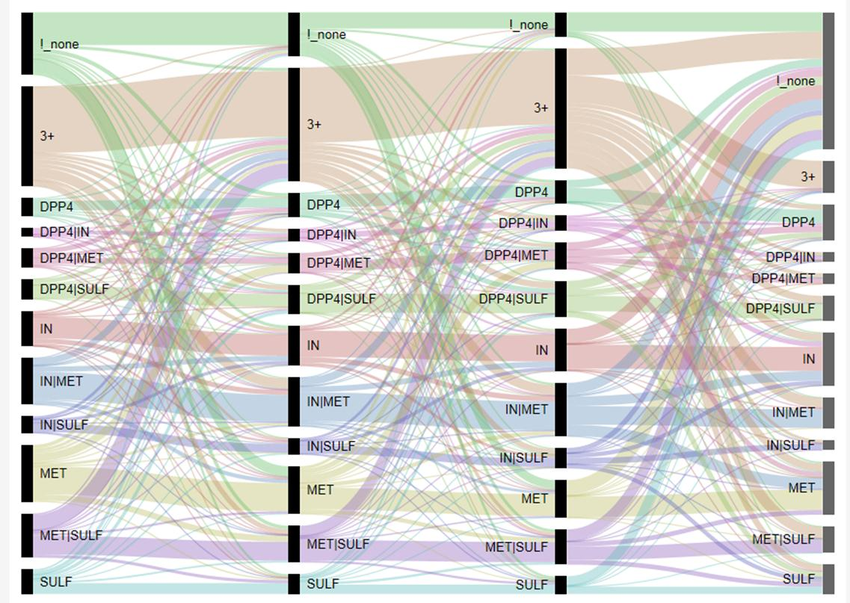
Polypharmacy progression prior to Canagliflozin initiation (far right)
Canagliflozin only!
Notes:
Here is what I got as far as (3 year) treatment progression up to the time of canagliflozin initiation.
The first three bars (from left to right) show treatments present in 360 day intervals prior to initiation
1st bar -1080 to -721 days
2nd bar -720 to -361
3rd bar -360 to -1
4th bar 0 to 180 (where 0 is day of initiation of canagliflozin)
!! Note: Everyone on the far right bar also received canagliflozin in addition to what is shown

Slide 7
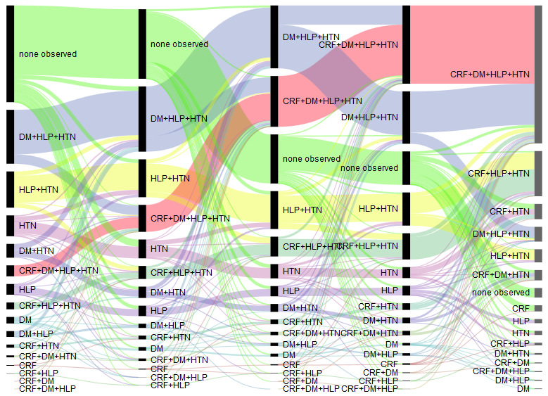
8 years prior
6 years prior
4 years prior
2 years prior
Day of Dialysis
CRF=Chronic Renal Failure
DM=Diabetes
HLP=Hyperlipidemia
HTN=Hypertension

Slide 8
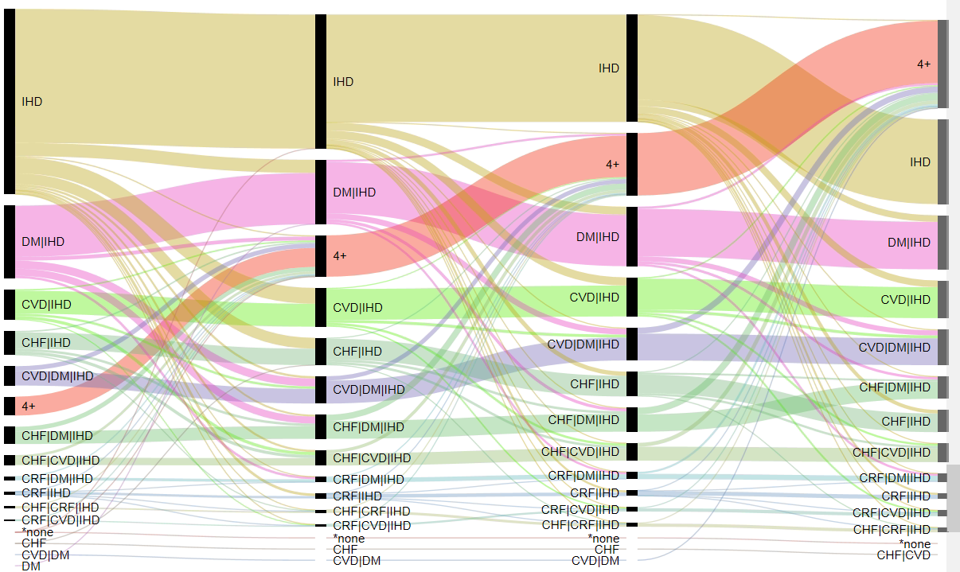
Comorbidity/frailty “load” of 16.5K intracoronary stent patients after insertion
Stent placed
Stent placed+2 years
Stent placed+4 years
Stent placed+6 years
Notes:
IHD- ischemic heart disease
DM- diabetes
CVD- cerebral vascular disease
CRF- chronic renal failure
CHF- congestive heart failure

Slide 9
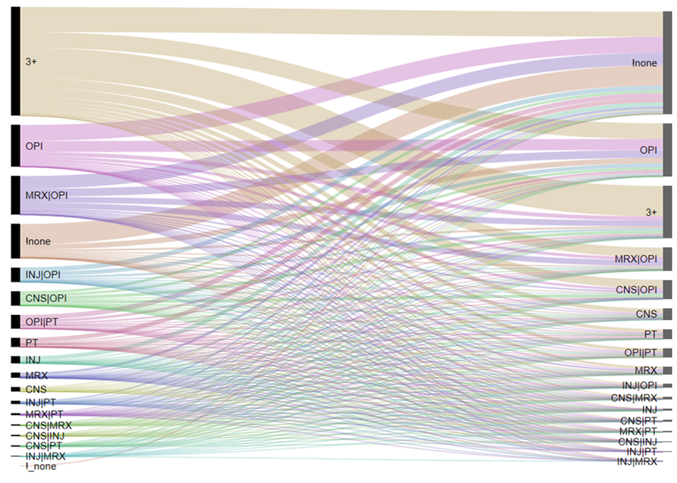
Aggregate of year prior (far left) and paths to 2 years post (far right.. actually 360 to 720 days after surgery)

Slide 10
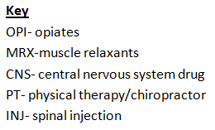
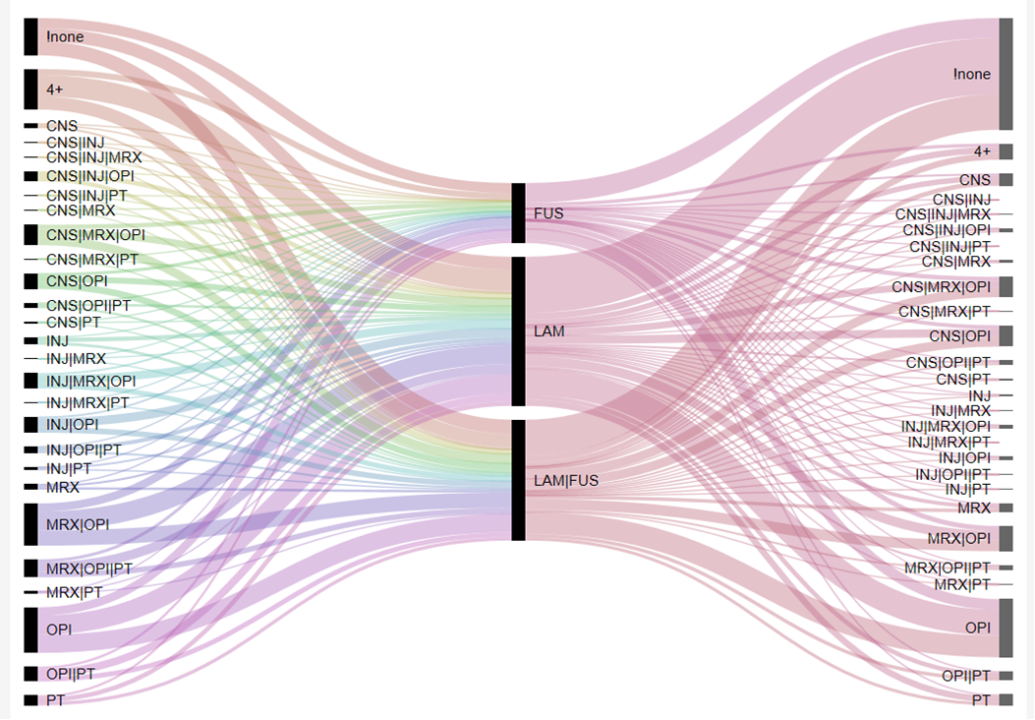
Therapies used before and after fusion/laminectomy events
Therapy combinations
1 yr to 1 day prior
To surgery
Therapy combinations
1 yr to 2 yrs post
surgery

Slide 11
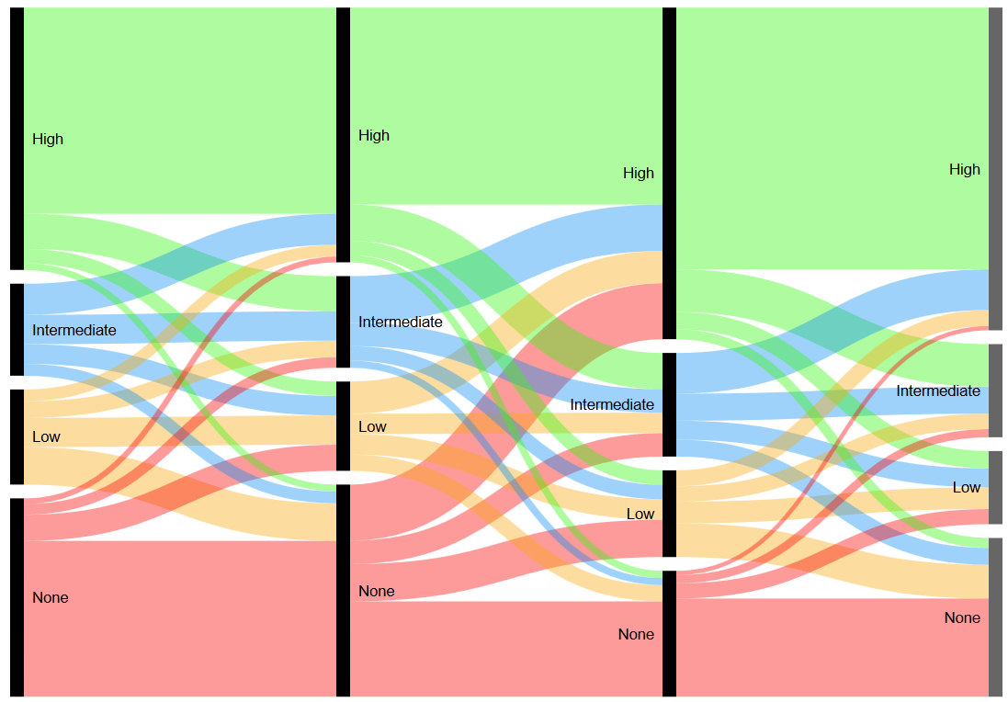
AMI influence on Statin possession ratios
2 years pre-AMI
1 year pre-AMI
AMI event
1 year post-AMI
2 years post-AMI
“steady state” proportion of people
switching from none to highly
compliant
Proportion of people switching
from none to highly
compliant after AMI.
Notes:
create temp table foo_1st_AMI as select iv.*,eff_dt,end_dt from ( select optum_lab_id, min(service_from_date) first_ami_date--,count_days_supply ,b.generic_name from restrictedstateview..facility_claim a ,restrictedstateview..diagnosis b where a.header_diagnosis_1_key=b.diagnosis_key and CATEGORY_DTL_CODE_DESC='ACUTE MYOCARDIAL INFARCTION' group by optum_lab_id ) iv ,restrictedstateview..mcr_Intermediate_rx_ce c where iv.optum_lab_id=c.optum_lab_id and first_ami_date between eff_dt+720 and end_dt-720 drop table foo_ami_with_coa create temp table foo_ami_with_coa as select a.*,min_fill from foo_1st_AMI a , ( select optum_lab_id,min(fill_date) min_fill FROM ( SELECT optum_lab_id,fill_date from restrictedstateview..pharmacy_claim a ,restrictedstateview..ndc b where a.ndc_key=b.ndc_key and generic_name like '%STATIN%' and generic_name not like '%PENTOSTATIN%' and generic_name not like '%NYSTATIN%' --AHFS_THERAPEUTIC_CLASS_DESC ='HMG-COA REDUCTASE INHIBITORS' UNION ALL SELECT optum_lab_id,fill_date from restrictedstateview..pharmacy_claim_PARTD a ,restrictedstateview..ndc b where a.ndc_key=b.ndc_key and generic_name like '%STATIN%' and generic_name not like '%PENTOSTATIN%' and generic_name not like '%NYSTATIN%' --AHFS_THERAPEUTIC_CLASS_DESC ='HMG-COA REDUCTASE INHIBITORS' ) IV1 group by optum_lab_id ) iv where a.optum_lab_id=iv.optum_lab_id and first_ami_date between min_fill+720 and '2013-01-01' select * from foo_ami_with_coa limit 100 drop table foo_pr_ami create temp table foo_pr_ami as select iv.optum_lab_id,first_ami_date,min_fill ,sum(case when fill_date between first_ami_date-720 and first_ami_date-360 then count_days_supply else 0 end ) m720m360 ,sum(case when fill_date between first_ami_date-359 and first_ami_date-0 then count_days_supply else 0 end ) m360p0 ,sum(case when fill_date between first_ami_date+0 and first_ami_date+360 then count_days_supply else 0 end ) p0p360 ,sum(case when fill_date between first_ami_date+361 and first_ami_date+720 then count_days_supply else 0 end ) p360p720 from foo_ami_with_coa iv , ( SELECT optum_lab_id,fill_date,count_days_supply from restrictedstateview..pharmacy_claim a ,restrictedstateview..ndc b where a.ndc_key=b.ndc_key and generic_name like '%STATIN%' and generic_name not like '%PENTOSTATIN%' and generic_name not like '%NYSTATIN%' --AHFS_THERAPEUTIC_CLASS_DESC ='HMG-COA REDUCTASE INHIBITORS' UNION SELECT optum_lab_id,fill_date,count_days_supply from restrictedstateview..pharmacy_claim_PARTD a ,restrictedstateview..ndc b where a.ndc_key=b.ndc_key and generic_name like '%STATIN%' and generic_name not like '%PENTOSTATIN%' and generic_name not like '%NYSTATIN%' --AHFS_THERAPEUTIC_CLASS_DESC ='HMG-COA REDUCTASE INHIBITORS' ) A where a.optum_lab_id=iv.optum_lab_id group by iv.optum_lab_id,first_ami_date,min_fill GO select * from foo_pr_ami select m720m360,m360p0,p0p360,p360p720,count(0) c from ( select optum_lab_id ,max(case when m720m360=0 then 'None' when m720m360 between 1 and 120 then 'Low' when m720m360 between 121 and 240 then 'Intermediate' when m720m360 between 241 and 9999 then 'High' else null end) m720m360 ,max(case when m360p0=0 then 'None' when m360p0 between 1 and 120 then 'Low' when m360p0 between 121 and 240 then 'Intermediate' when m360p0 between 241 and 9999 then 'High' else null end) m360p0 ,max(case when p0p360=0 then 'None' when p0p360 between 1 and 120 then 'Low' when p0p360 between 121 and 240 then 'Intermediate' when p0p360 between 241 and 9999 then 'High' else null end) p0p360 ,max(case when p360p720=0 then 'None' when p360p720 between 1 and 120 then 'Low' when p360p720 between 121 and 240 then 'Intermediate' when p360p720 between 241 and 9999 then 'High' else null end) p360p720 from foo_pr_ami group by optum_lab_id ) iv group by m720m360,m360p0,p0p360,p360p720 #NAME? select optum_lab_id ,max(case when m720m360=0 then 'no days' when m720m360 between 1 and 30 then 'lt30days' when m720m360 between 31 and 180 then 'lt180days' when m720m360 between 181 and 9999 then 'gt180days' else null end) m720m360 ,max(case when m360p0=0 then 'no days' when m360p0 between 1 and 30 then 'lt30days' when m360p0 between 31 and 180 then 'lt180days' when m360p0 between 181 and 9999 then 'gt180days' else null end) m360p0 ,max(case when p0p360=0 then 'no days' when p0p360 between 1 and 30 then 'lt30days' when p0p360 between 31 and 180 then 'lt180days' when p0p360 between 181 and 9999 then 'gt180days' else null end) p0p360 ,max(case when p360p720=0 then 'no days' when p360p720 between 1 and 30 then 'lt30days' when p360p720 between 31 and 180 then 'lt180days' when p360p720 between 181 and 9999 then 'gt180days' else null end) p360p720 from foo_pr_ami group by optum_lab_id OPTUM_LAB_ID 52712 54095 392704 555381 560554 619437 780038 select * from foo_pr_ami where optum_lab_id in (24079927,46164824) OPTUM_LAB_ID 24079927 46164824 select optum_lab_id,fill_date,generic_name,AHFS_THERAPEUTIC_CLASS_DESC,COUNT_DAYS_SUPPLY from restrictedstateview..pharmacy_claim a ,restrictedstateview..ndc b where a.ndc_key=b.ndc_key --and AHFS_THERAPEUTIC_CLASS_DESC ='HMG-COA REDUCTASE INHIBITORS' and optum_lab_id in (24079927,46164824) and generic_name like '%STATIN%' and generic_name not like '%PENTOSTATIN%' and generic_name not like '%NYSTATIN%' --AHFS_THERAPEUTIC_CLASS_DESC ='HMG-COA REDUCTASE INHIBITORS' order by optum_lab_id asc,fill_date asc

Slide 12
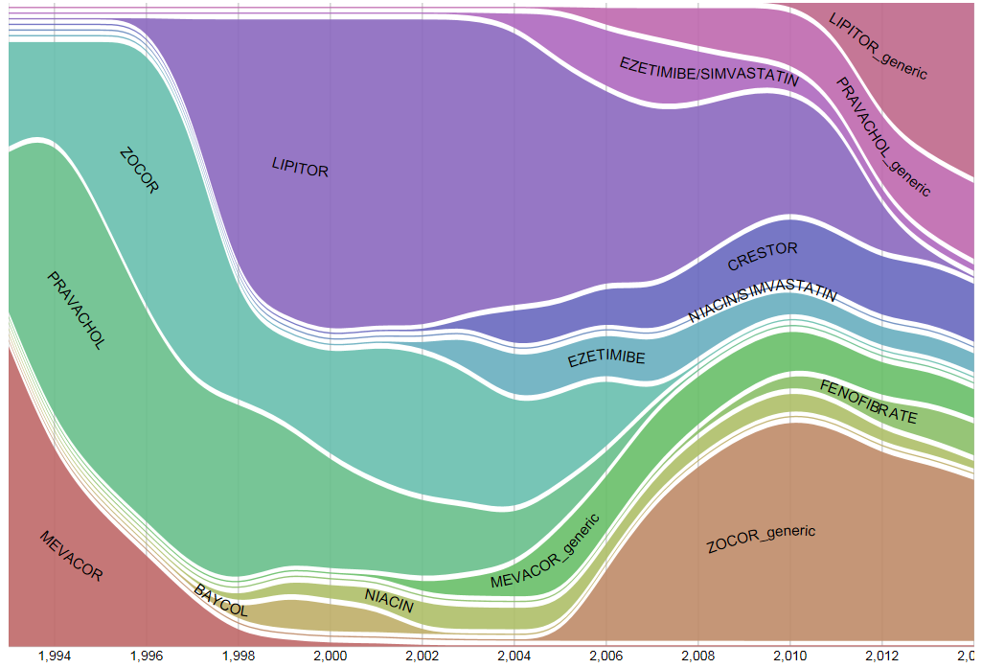
Lipid lowering landscape: 1993 to 2014

Slide 13
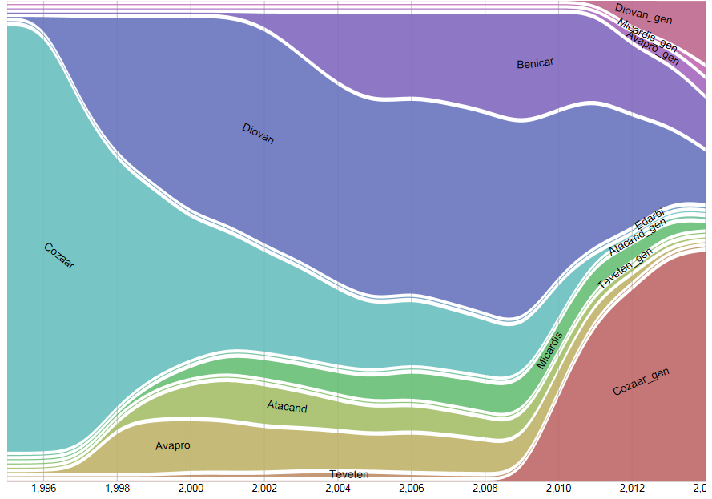
ARB landscape by fills by year

